Slide 1


Google Machine Learning courses
Notes:
https://developers.google.com/machine-learning/crash-course

Slide 2
What you will learn
Linear Regression
Logistic Regression
Classification
Working with Numerical Data
Working with Categorical Data
Datasets, Generalization, and Overfitting
Neural Networks
Embeddings
Large Language Models
Production ML Systems
AutoML
ML Fairness

Slide 3
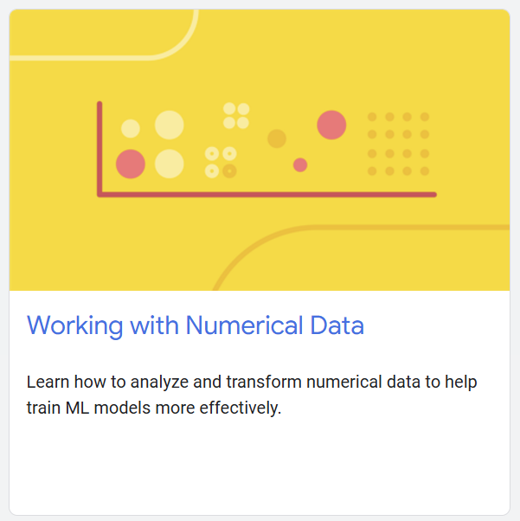
Working with numerical data
Notes:
https://developers.google.com/machine-learning/crash-course/numerical-data

Slide 4
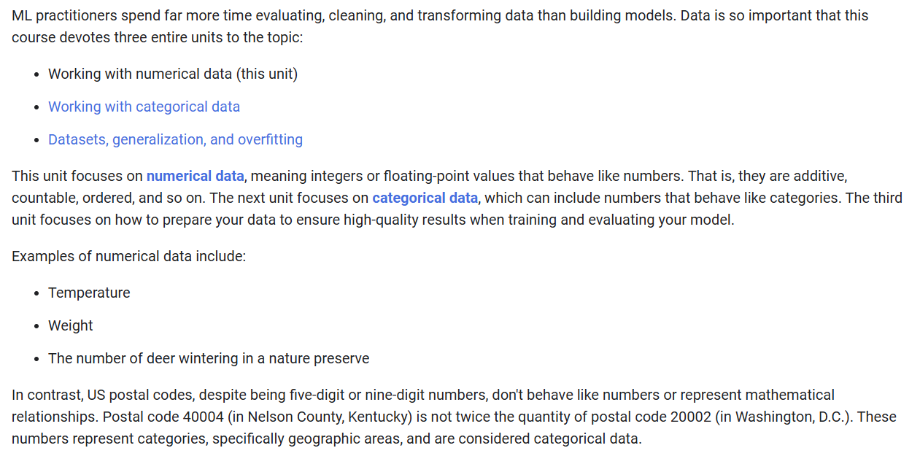

Slide 5
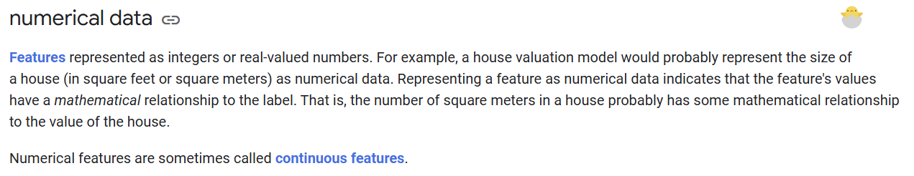

Slide 6
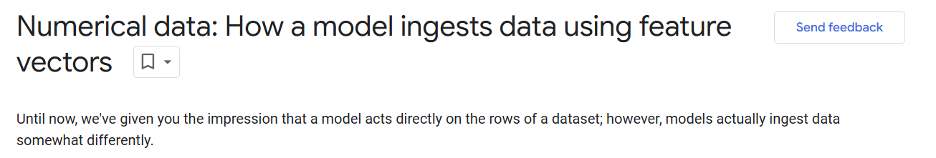

Slide 7
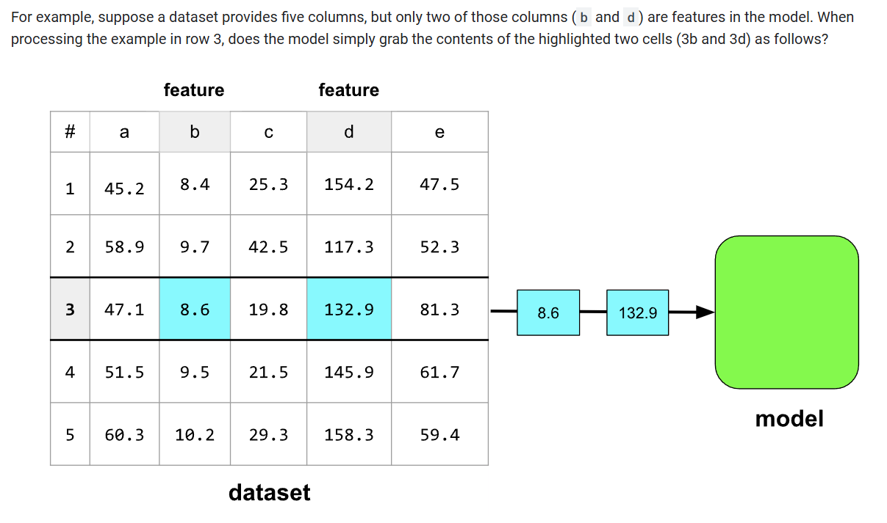

Slide 8
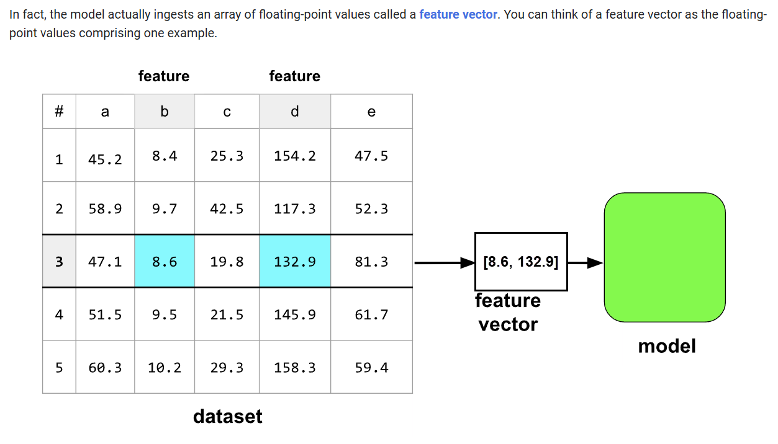

Slide 9
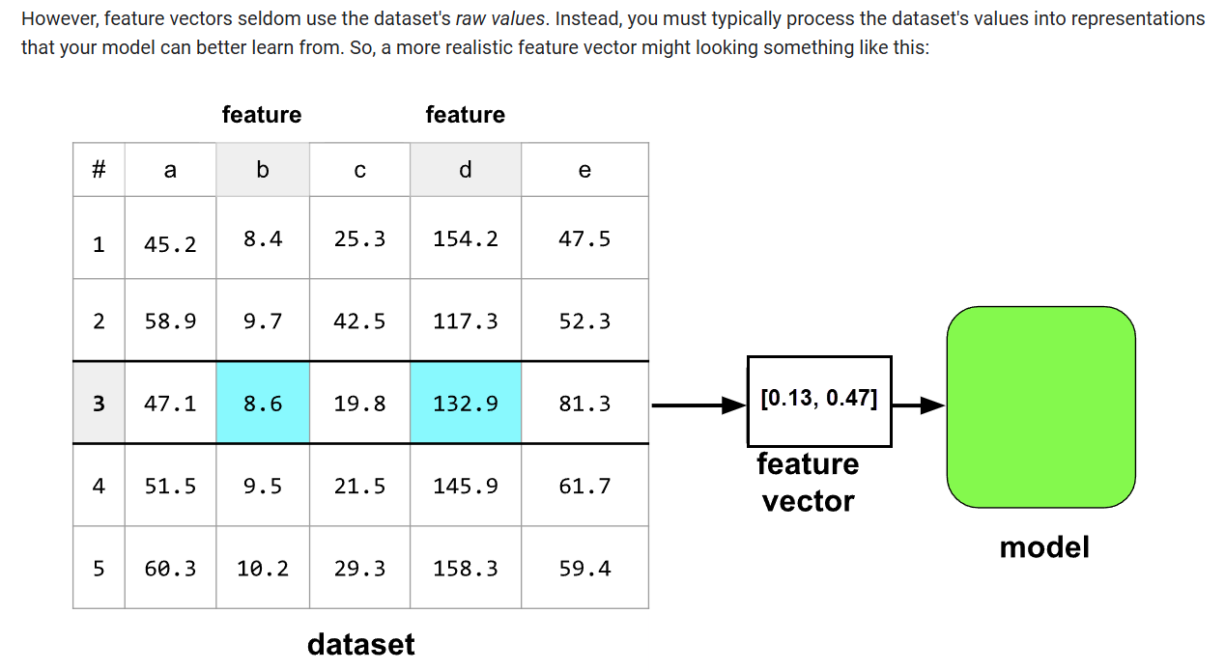

Slide 10
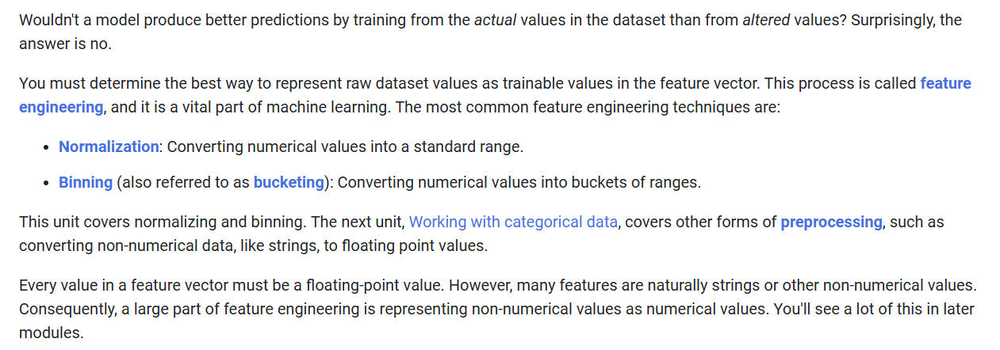

Slide 11
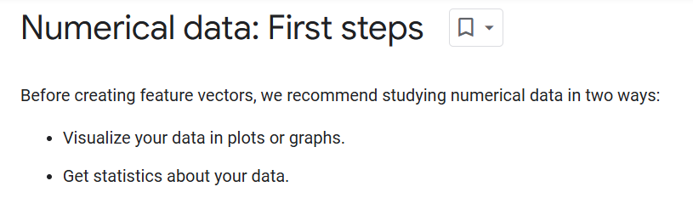

Slide 12
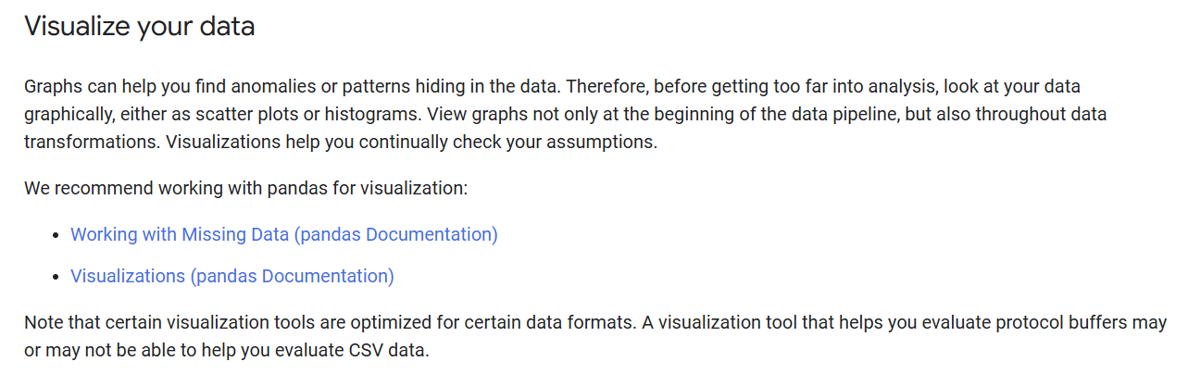

Slide 13
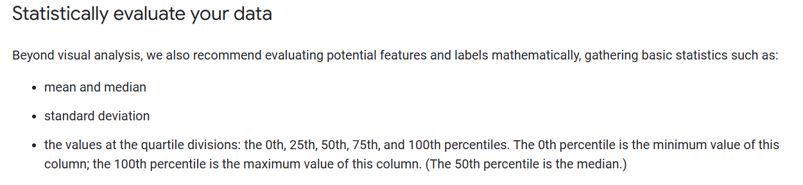

Slide 14

Notes:
https://pandas.pydata.org/pandas-docs/stable/index.html

Slide 15
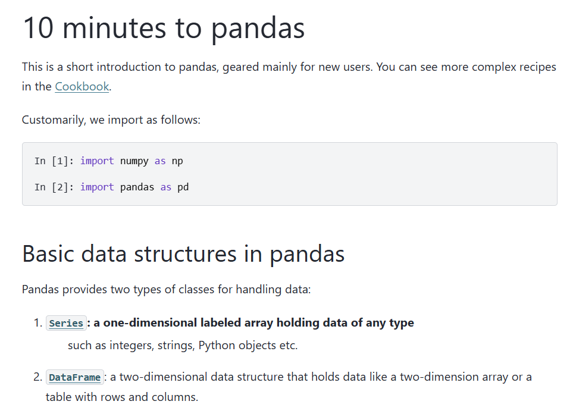
Notes:
https://pandas.pydata.org/pandas-docs/stable/user_guide/10min.html

Slide 16
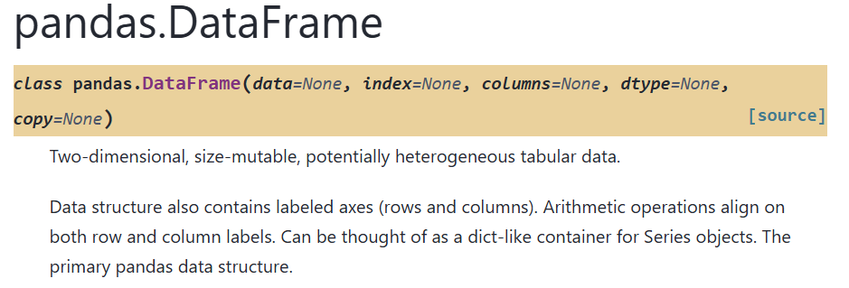
Notes:
https://pandas.pydata.org/pandas-docs/stable/reference/api/pandas.DataFrame.html#pandas.DataFrame

Slide 17
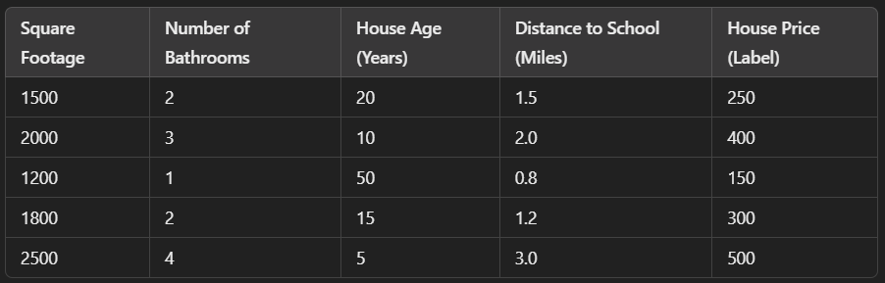

Slide 18
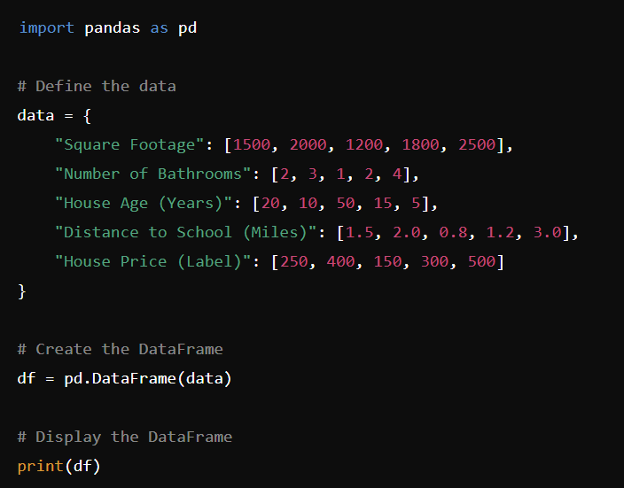
Notes:
import pandas as pd
# Define the data
data = {
"Square Footage": [1500, 2000, 1200, 1800, 2500],
"Number of Bathrooms": [2, 3, 1, 2, 4],
"House Age (Years)": [20, 10, 50, 15, 5],
"Distance to School (Miles)": [1.5, 2.0, 0.8, 1.2, 3.0],
"House Price (Label)": [250, 400, 150, 300, 500]
}
# Create the DataFrame
df = pd.DataFrame(data)
# Display the DataFrame
print(df)

Slide 19
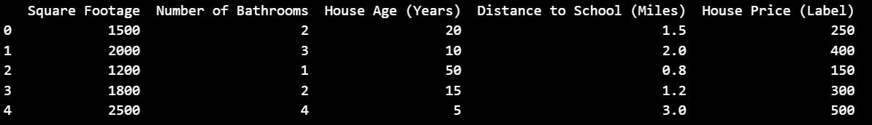
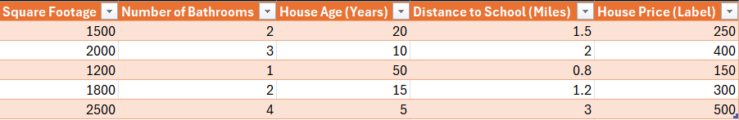
Look familiar?

Slide 20
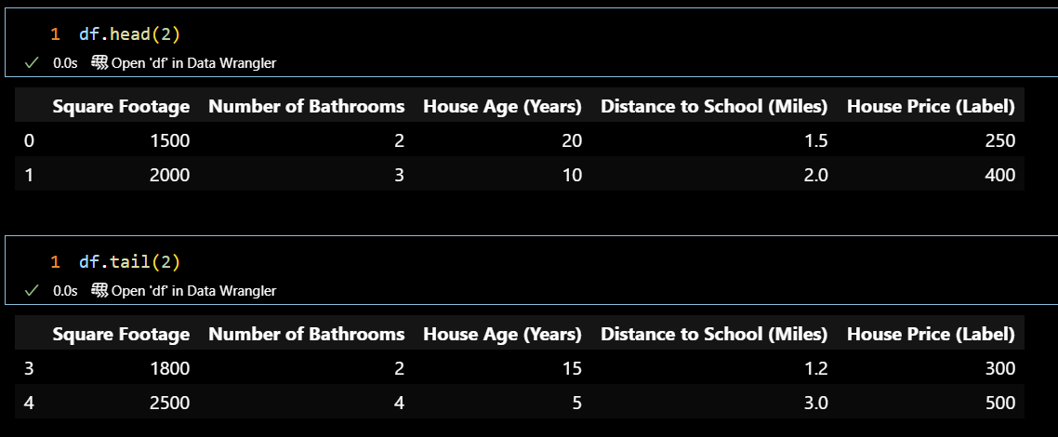
Heads or tails?

Slide 22
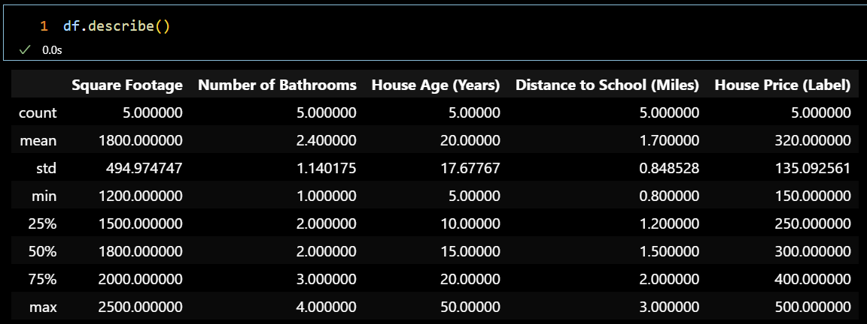
Stats, Stat!

Slide 23




Notes:
https://www.youtube.com/channel/UC35ZpwldGw7ZJ5R-2sLijzw

Slide 24


Membership has its privileges
Notes:
https://www.youtube.com/channel/UC35ZpwldGw7ZJ5R-2sLijzw/join

Slide 25

https://www.youtube.com/@AINewsFresh

Slide 26

https://www.youtube.com/@DailyAINewsPodcast

Slide 27

https://www.youtube.com/@AIPapersPodcastDaily

Slide 28
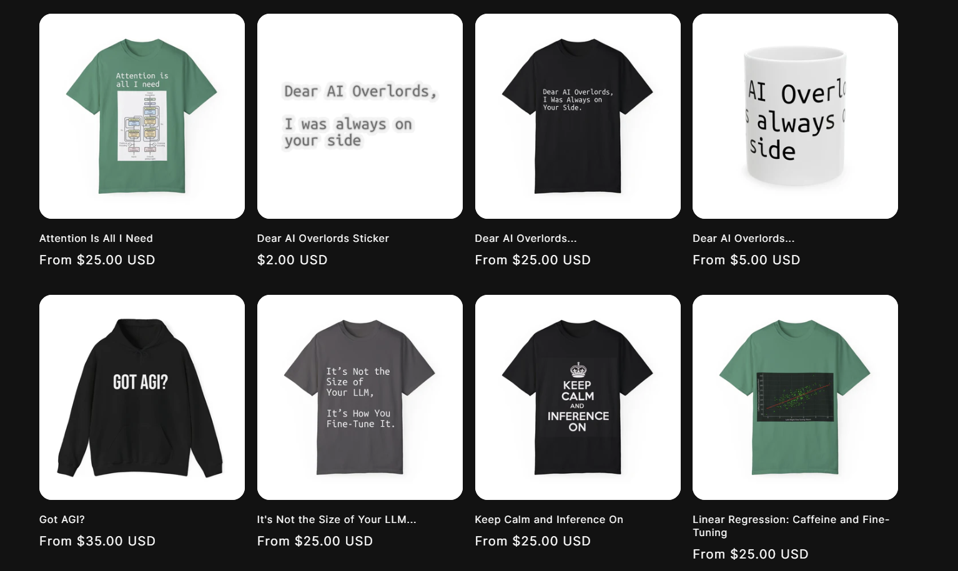
Shop.reallyeasy.ai
Notes:
https://653702-8a.myshopify.com/

Slide 29
Notes:
https://pandas.pydata.org/pandas-docs/stable/user_guide/missing_data.html
https://pandas.pydata.org/pandas-docs/stable/user_guide/visualization.html

Slide 30

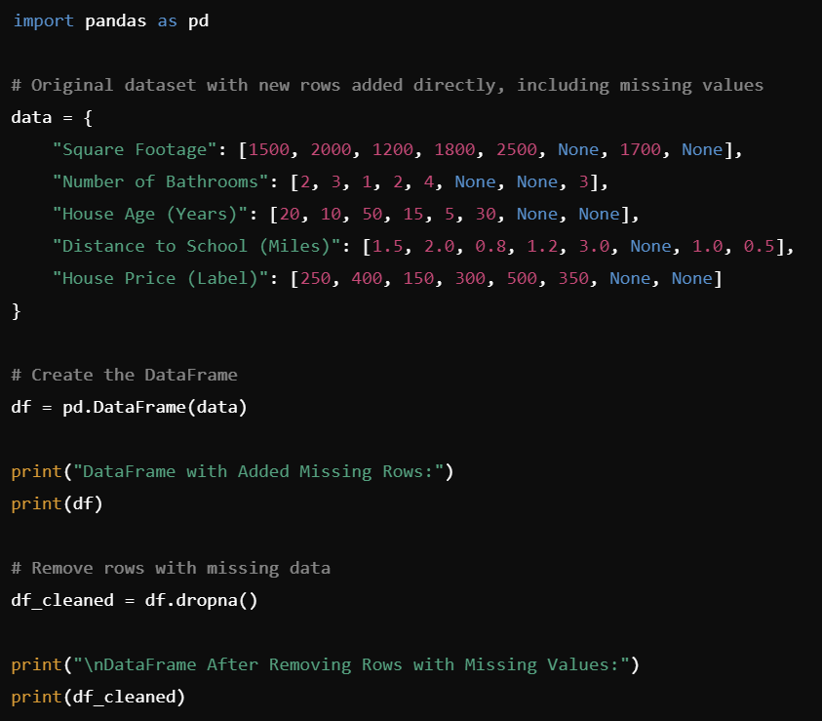
Notes:
import pandas as pd
# Original dataset with new rows added directly, including missing values
data = {
"Square Footage": [1500, 2000, 1200, 1800, 2500, None, 1700, None],
"Number of Bathrooms": [2, 3, 1, 2, 4, None, None, 3],
"House Age (Years)": [20, 10, 50, 15, 5, 30, None, None],
"Distance to School (Miles)": [1.5, 2.0, 0.8, 1.2, 3.0, None, 1.0, 0.5],
"House Price (Label)": [250, 400, 150, 300, 500, 350, None, None]
}
# Create the DataFrame
df = pd.DataFrame(data)
print("DataFrame with Added Missing Rows:")
print(df)
# Remove rows with missing data
df_cleaned = df.dropna()
print("\nDataFrame After Removing Rows with Missing Values:")
print(df_cleaned)

Slide 31
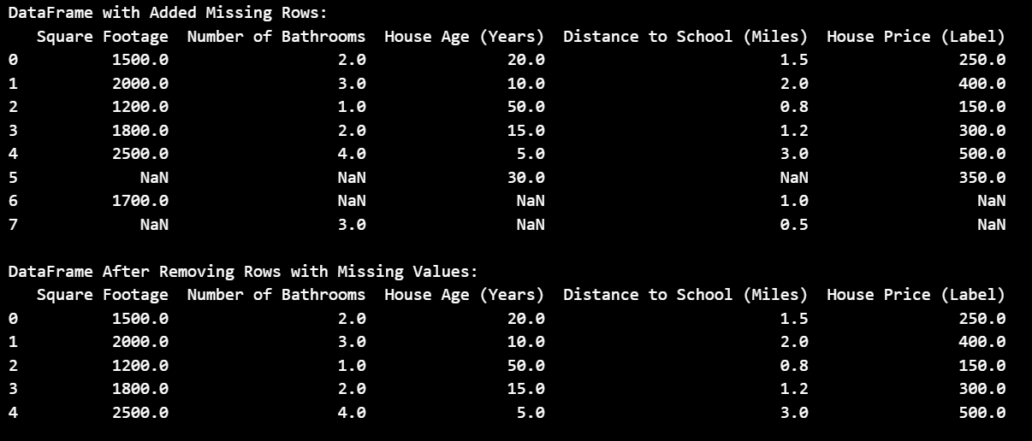

Slide 32
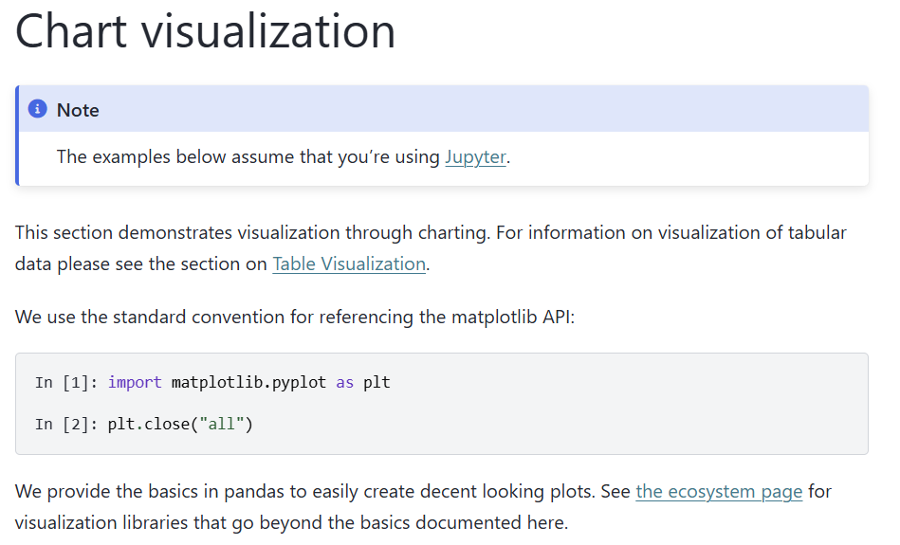
Notes:
https://pandas.pydata.org/pandas-docs/stable/user_guide/visualization.html

Slide 33
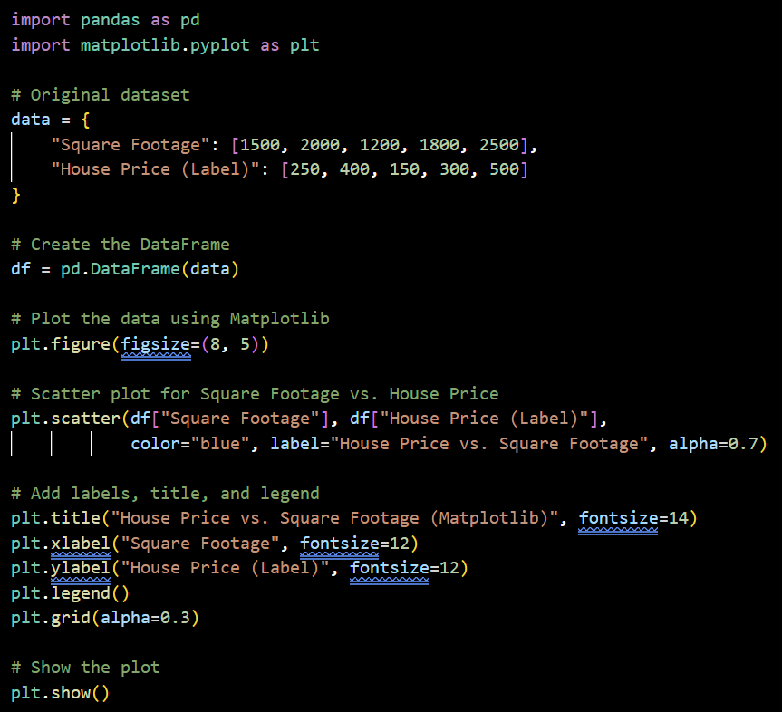
Notes:
import pandas as pd
import matplotlib.pyplot as plt
# Original dataset
data = {
"Square Footage": [1500, 2000, 1200, 1800, 2500],
"House Price (Label)": [250, 400, 150, 300, 500]
}
# Create the DataFrame
df = pd.DataFrame(data)
# Plot the data using Matplotlib
plt.figure(figsize=(8, 5))
# Scatter plot for Square Footage vs. House Price
plt.scatter(df["Square Footage"], df["House Price (Label)"], color="blue", label="House Price vs. Square Footage", alpha=0.7)
# Add labels, title, and legend
plt.title("House Price vs. Square Footage (Matplotlib)", fontsize=14)
plt.xlabel("Square Footage", fontsize=12)
plt.ylabel("House Price (Label)", fontsize=12)
plt.legend()
plt.grid(alpha=0.3)
# Show the plot
plt.show()

Slide 34
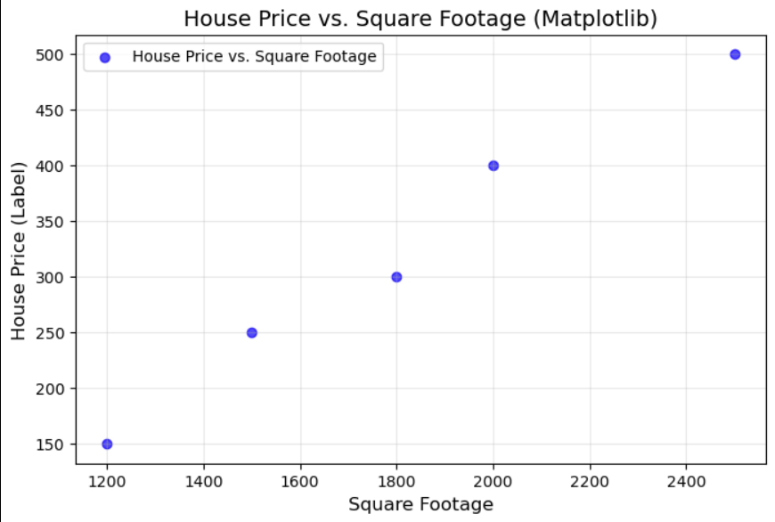

Slide 35
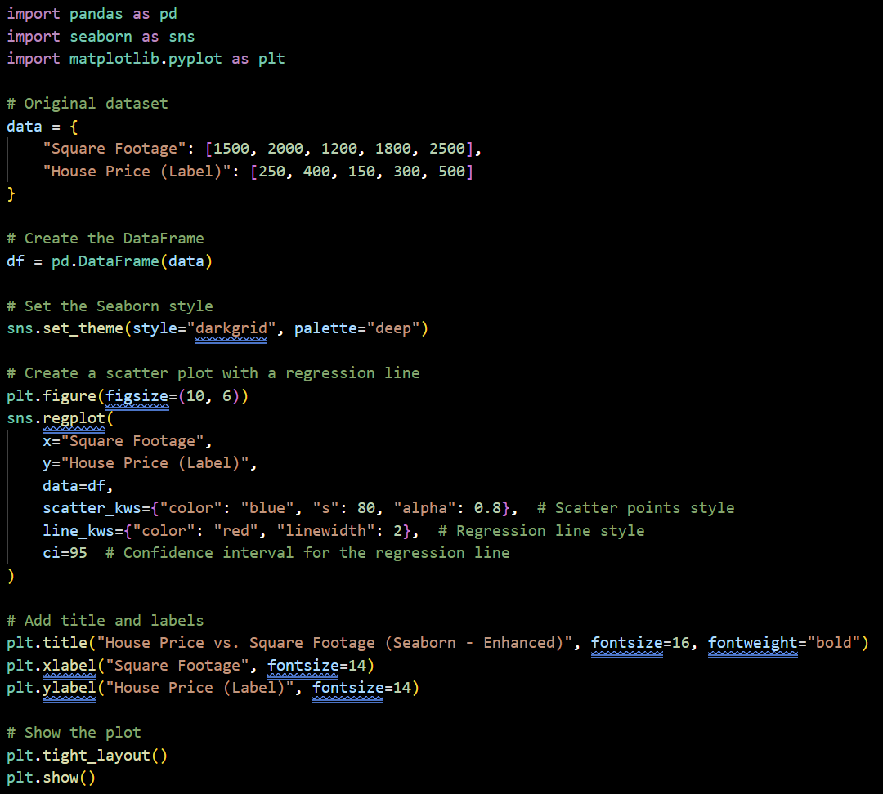
Notes:
import pandas as pd
import seaborn as sns
import matplotlib.pyplot as plt
# Original dataset
data = {
"Square Footage": [1500, 2000, 1200, 1800, 2500],
"House Price (Label)": [250, 400, 150, 300, 500]
}
# Create the DataFrame
df = pd.DataFrame(data)
# Set the Seaborn style
sns.set_theme(style="darkgrid", palette="deep")
# Create a scatter plot with a regression line
plt.figure(figsize=(10, 6))
sns.regplot(
x="Square Footage",
y="House Price (Label)",
data=df,
scatter_kws={"color": "blue", "s": 80, "alpha": 0.8}, # Scatter points style
line_kws={"color": "red", "linewidth": 2}, # Regression line style
ci=95 # Confidence interval for the regression line
)
# Add title and labels
plt.title("House Price vs. Square Footage (Seaborn - Enhanced)", fontsize=16, fontweight="bold")
plt.xlabel("Square Footage", fontsize=14)
plt.ylabel("House Price (Label)", fontsize=14)
# Show the plot
plt.tight_layout()
plt.show()

Slide 36
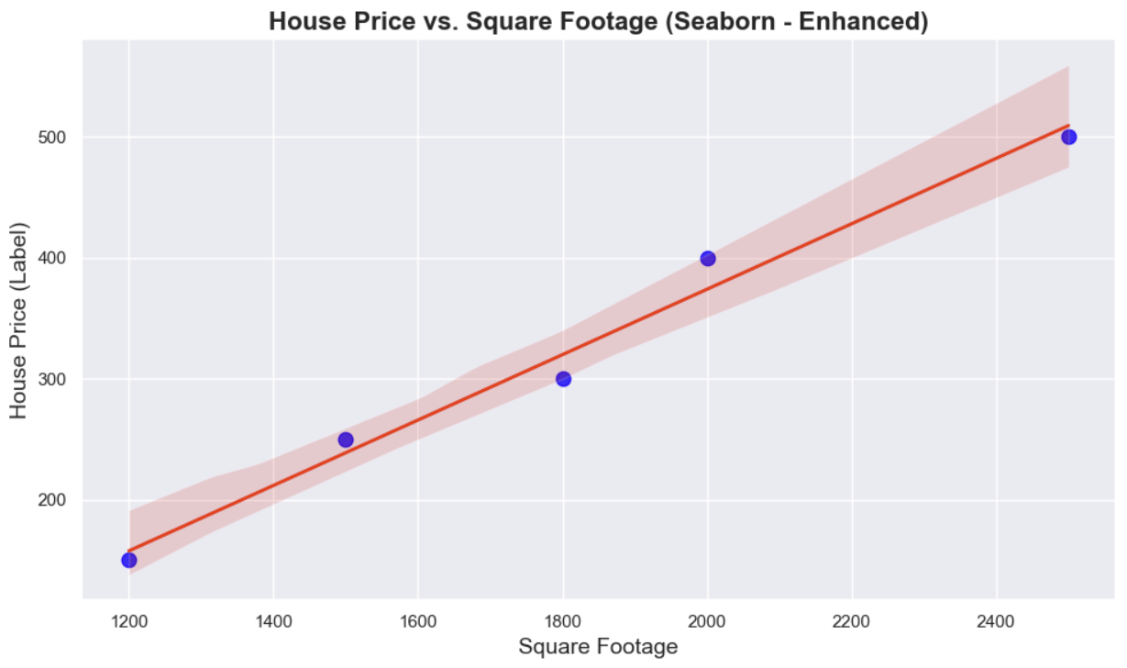

Slide 37
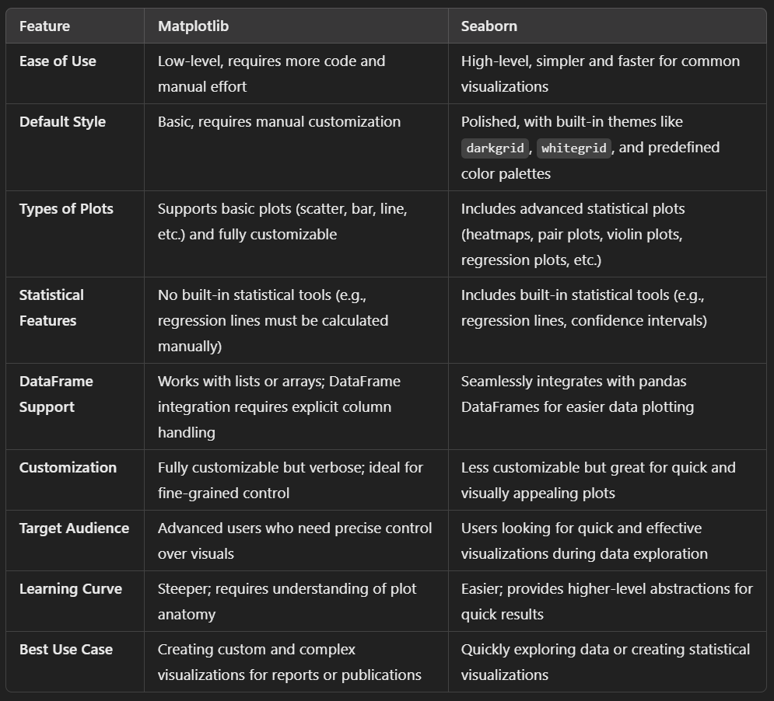

Slide 38
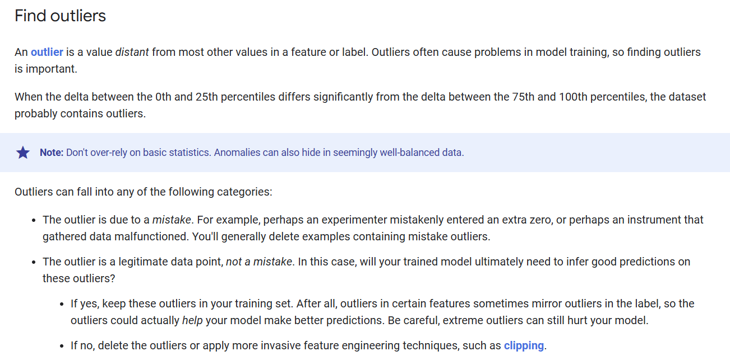

Slide 39
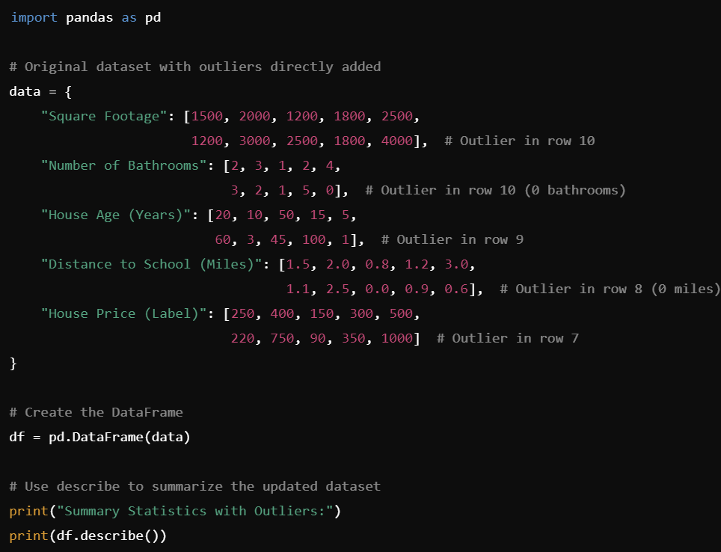
Notes:
import pandas as pd
# Original dataset with outliers directly added
data = {
"Square Footage": [1500, 2000, 1200, 1800, 2500,
1200, 3000, 2500, 1800, 4000], # Outlier in row 10
"Number of Bathrooms": [2, 3, 1, 2, 4,
3, 2, 1, 5, 0], # Outlier in row 10 (0 bathrooms)
"House Age (Years)": [20, 10, 50, 15, 5,
60, 3, 45, 100, 1], # Outlier in row 9
"Distance to School (Miles)": [1.5, 2.0, 0.8, 1.2, 3.0,
1.1, 2.5, 0.0, 0.9, 0.6], # Outlier in row 8 (0 miles)
"House Price (Label)": [250, 400, 150, 300, 500,
220, 750, 90, 350, 1000] # Outlier in row 7
}
# Create the DataFrame
df = pd.DataFrame(data)
# Use describe to summarize the updated dataset
print("Summary Statistics with Outliers:")
print(df.describe())

Slide 40
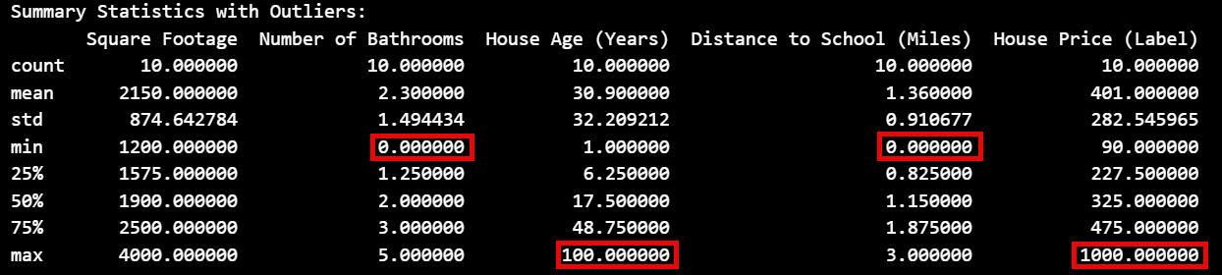

Slide 41
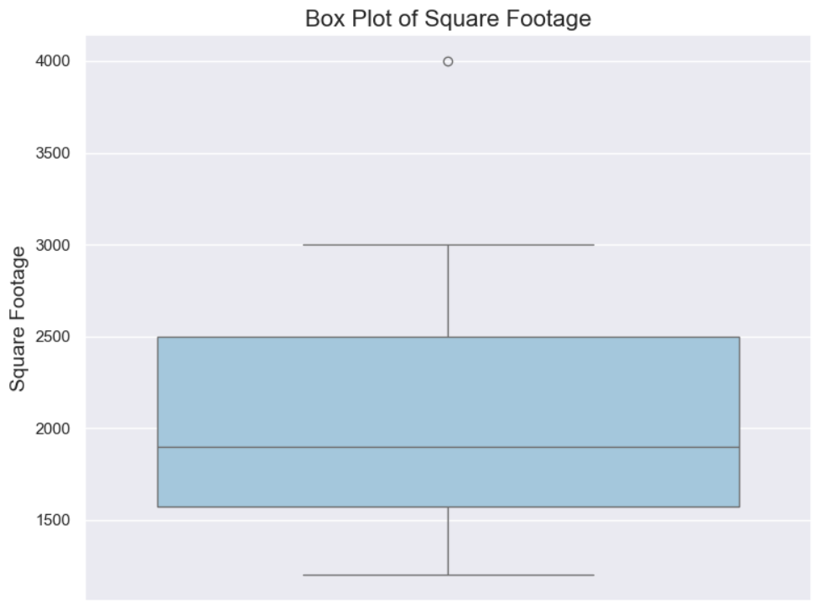

Slide 42
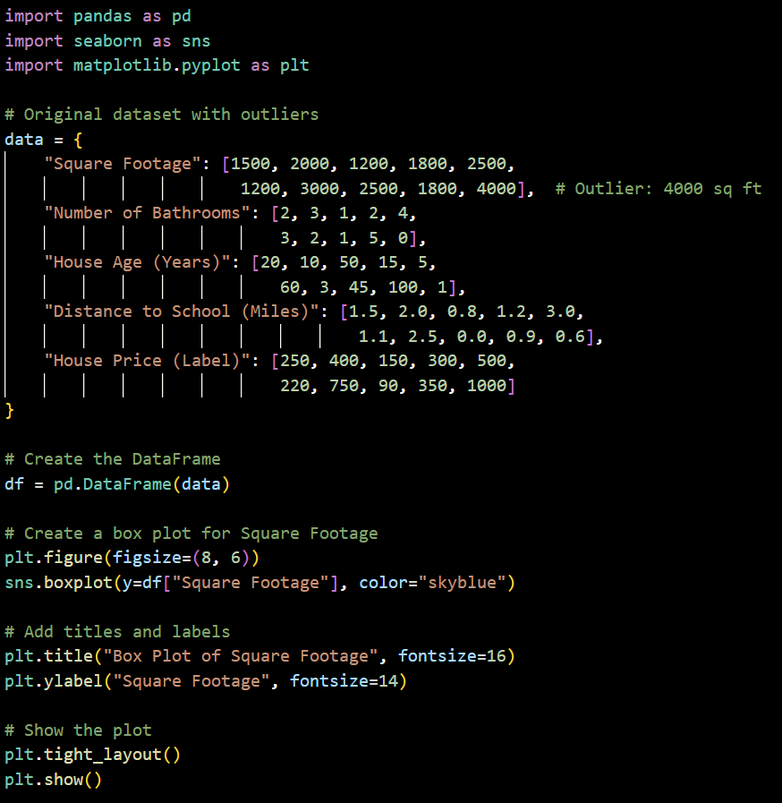
Notes:
import pandas as pd
import seaborn as sns
import matplotlib.pyplot as plt
# Original dataset with outliers
data = {
"Square Footage": [1500, 2000, 1200, 1800, 2500,
1200, 3000, 2500, 1800, 4000], # Outlier: 4000 sq ft
"Number of Bathrooms": [2, 3, 1, 2, 4,
3, 2, 1, 5, 0],
"House Age (Years)": [20, 10, 50, 15, 5,
60, 3, 45, 100, 1],
"Distance to School (Miles)": [1.5, 2.0, 0.8, 1.2, 3.0,
1.1, 2.5, 0.0, 0.9, 0.6],
"House Price (Label)": [250, 400, 150, 300, 500,
220, 750, 90, 350, 1000]
}
# Create the DataFrame
df = pd.DataFrame(data)
# Create a box plot for Square Footage
plt.figure(figsize=(8, 6))
sns.boxplot(y=df["Square Footage"], color="skyblue")
# Add titles and labels
plt.title("Box Plot of Square Footage", fontsize=16)
plt.ylabel("Square Footage", fontsize=14)
# Show the plot
plt.tight_layout()
plt.show()

Slide 43
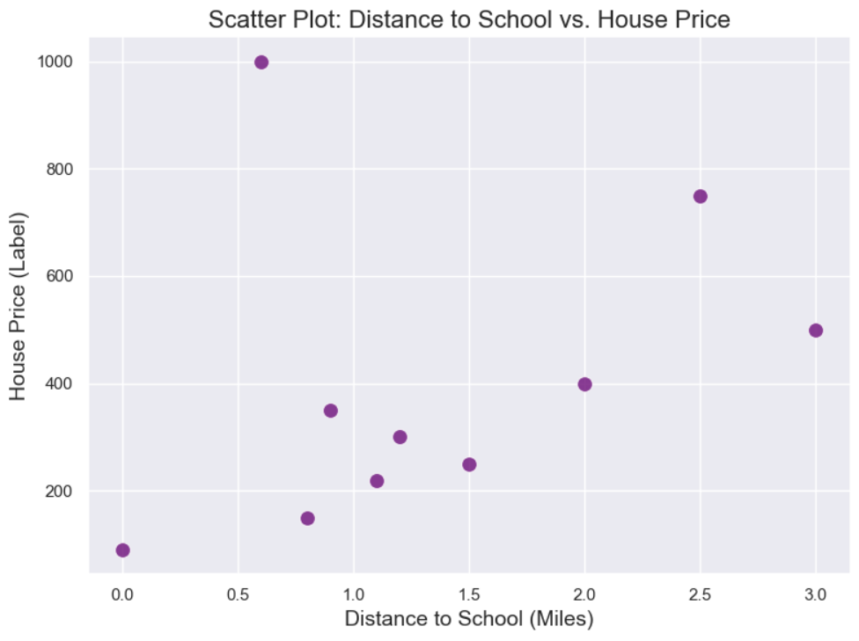

Slide 44
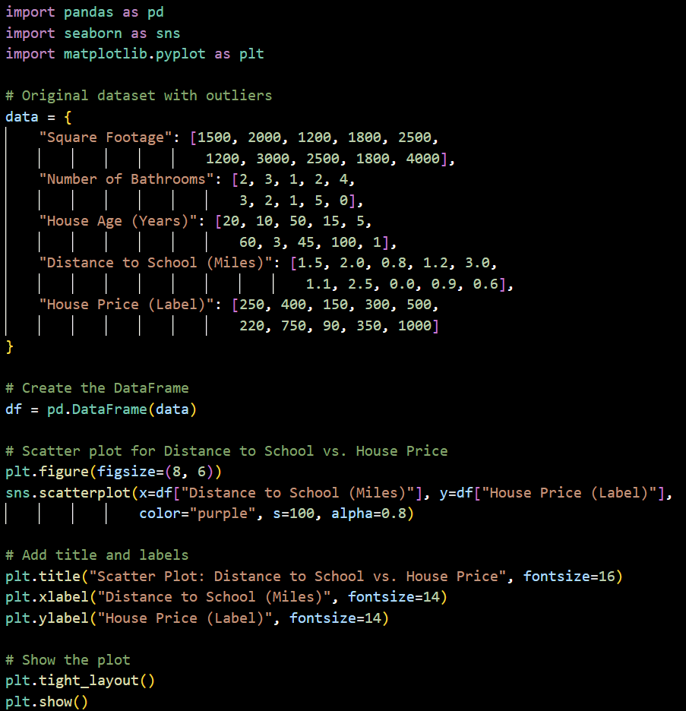
Notes:
import pandas as pd
import seaborn as sns
import matplotlib.pyplot as plt
# Original dataset with outliers
data = {
"Square Footage": [1500, 2000, 1200, 1800, 2500,
1200, 3000, 2500, 1800, 4000],
"Number of Bathrooms": [2, 3, 1, 2, 4,
3, 2, 1, 5, 0],
"House Age (Years)": [20, 10, 50, 15, 5,
60, 3, 45, 100, 1],
"Distance to School (Miles)": [1.5, 2.0, 0.8, 1.2, 3.0,
1.1, 2.5, 0.0, 0.9, 0.6],
"House Price (Label)": [250, 400, 150, 300, 500,
220, 750, 90, 350, 1000]
}
# Create the DataFrame
df = pd.DataFrame(data)
# Scatter plot for Distance to School vs. House Price
plt.figure(figsize=(8, 6))
sns.scatterplot(x=df["Distance to School (Miles)"], y=df["House Price (Label)"],
color="purple", s=100, alpha=0.8)
# Add title and labels
plt.title("Scatter Plot: Distance to School vs. House Price", fontsize=16)
plt.xlabel("Distance to School (Miles)", fontsize=14)
plt.ylabel("House Price (Label)", fontsize=14)
# Show the plot
plt.tight_layout()
plt.show()

Slide 45
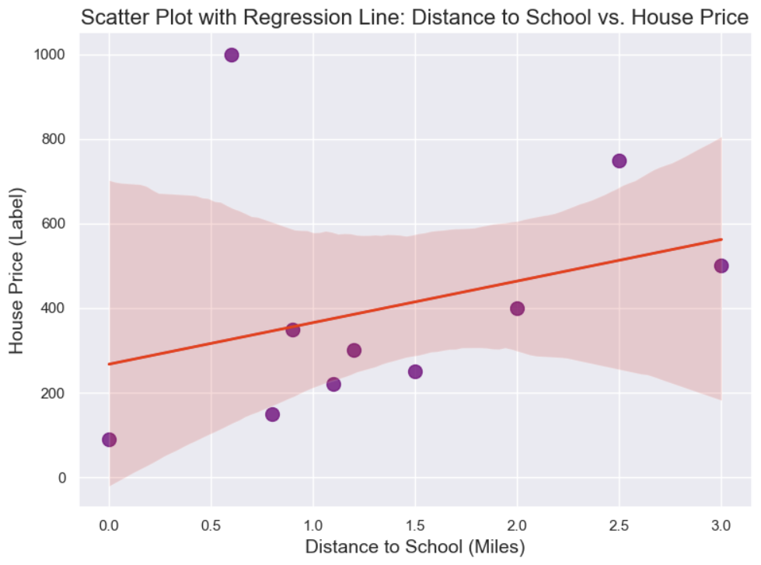

Slide 46
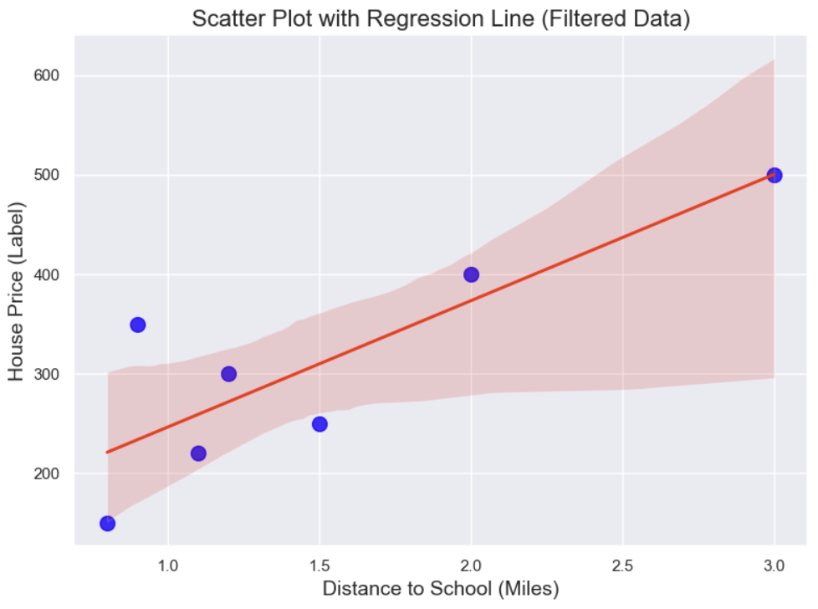

Slide 47
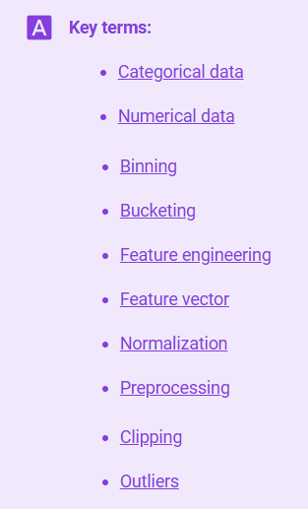
Notes:
https://developers.google.com/machine-learning/glossary

Slide 48


